Slide 1
Welcome to Virtusa – Pre-Recruitment Presentation

Slide 2
Global leader in digital engineering and transformational IT services
COMPANY OVERVIEW
Industry expertise
Banking and Financial Services
Insurance
Healthcare
Life Sciences
Telecom
Media and Entertainment
High Tech
Core services
Consulting and System Design
Application Engineering
Analytics, Insights and Data
Digital Process Automation
Intelligent Automation
Enterprise Application Integration
Cloud Services
Managed Services
25
Countries
50+
Locations
30,000+
World class professionals
Differentiators
Speed at Scale
Deep Engineering History
Business and Industry Focus
Digital Transformation Studio
Talent Development Pipeline
220+
Clients
Notes:
The global IT services market has many types of companies ranging from Gen 1 outsourcing firms to Global consulting and system integration firms. Virtusa has stayed true to its original roots as an technology engineering firm focused on transformational change. With the level of Digital and Cloud Transformation happening on market we are a good fit for clients looking for an experienced and differentiated IT services firm who can help them drive their Digital transformation at both speed and scale. Our company is presently a 1.3B global IT services firm with over 20K staff operating across 20 countries. We have the size and scale to deliver complex programs and enterprise wide transformations. We are focused in select industries with a core of our business established within the Banking and Financial Services, Healthcare and Life Sciences, Telco and Media and High Tech Industries. We offer a full set of services across Consulting and Design, Digital Engineering, Cloud Transformation and Managed Services. We continue to win multiple awards for innovation and most recently were ranked by Everest as the #1 service provider in our pier group and top challenger to the larger global brand names. Our key differentiators include: - Maniacal focus to drive speed and innovation at scale - Deep Engineering Lineage. Transformation requires specialty builders vs. generalist integration partners. - A strong focus and knowledge of business and industry domain. A high degree of consulting led engagements to drive business outcomes. - Our DTS offering is a unique differentiator to drive open innovation.

Slide 3
Why Virtusa
COMPANY OVERVIEW
Closing the gap, accelerating your business transformation
Multi-disciplinary agile teams of consultants, designers, engineers and sophisticated gamified tools
Deep domain and digital engineering expertise
Proven tools, assets and processes embedded in the Digital Transformation Studio model
End to end service offerings, from design to delivery & optimization
A deep talent development pipeline that is real-time responsive to client engagement demands
Speed at scale
Forward, Faster

Slide 4




Our Values
PASSION
Inspire to deliver extraordinary results
INNOVATION
Apply intellectual
curiosity to reimagine better outcomes
RESPECT
treat everyone with dignity
LEADERSHIP
Take personal
responsibility when things go aw ry
We are energetic, nimble and disruptive

Slide 5
Our broader service offerings
COMPANY OVERVIEW
Consulting & design services
Digital engineering services
Cloud services
Managed services
UI/UX design
Business capability modeling
Customer journey mapping
IT strategy and architecture
Accelerated solution design
Operational process design
DevOps design
Product design
Distributed agile
Application platform engineering
Content and customer experience
Digital process automation
Intelligent automation
Analytics, insights, and data
AI and machine learning
Industrial Internet of Things (IIoT)
Enterprise applications - SAP, Microsoft, Oracle, Pega
Strategy and assessments
Migration
Cloud native engineering
Data and analytics
SaaS applications
Open innovation platform
Security
Managed cloud
Application support and management
Infrastructure management services
Knowledge process outsourcing
Digital process outsourcing (Bots)
Independent validation (QA/testing)
5
Copyright © 2021 Virtusa Corporation. All Rights Reserved.
Notes:
We offer a full set of services across Consulting and Design, Digital Engineering, Cloud Transformation and Managed Services. Consulting and Design Services - Full-service consulting service and digital design partner. Our focus is less on corporate strategy consulting and more aligned to the ideation and design of new business models and platforms in the core industries we serve. Most all of our large Digital programs are Virtusa consulting led. Digital Engineering - The core strength of the company. Ranked as a global leader in Digital Process Automation (BPM, RPA, AI/ML, LowCode Engineering). Our engineering services are fully gamified across the company. Intense focus on code quality and reuse. Deep level of DevOps automation across the entire SDLC process. One of the top pure IT engineering companies in the global market. Cloud Transformation - Full-service cloud provider. Provide assessment, migration and managed cloud services. Partnerships with all of the major CSPs (AWS, Google, Microsoft, IBM/Redhat, VMWare/Pivotal). Market leader in complex cloud data migrations. Go-to partner of AWS for complex transformations at scale (e.g. Newscorp, AIG). Deep experience in Google GCP (top 5 client of Virtusa). Managed Services - Full-service provider for application, infrastructure and cloud managed services. Focus on driving Digital business process automation through Intelligent Automation (Digital BPO).

Slide 6





Our people
COMPANY OVERVIEW
We deliver measurably better engineering enabled by a culture of cooperation.
Empowered experts Empowered with cutting edge knowledge and opportunity, our teams have the deep industry and technical expertise required to create holistic solutions that drive business forward, faster.
On a mission Everything we create, we do so with a mind for reuse for every client to attain incomparable efficiencies, quality and speed through ‘low code’.
Driven by our core values
Agile in thought and transparent in action, our organization is innately driven to find a better way through passion, innovation, respect, and leadership.
Notes:
Britain’s Top Employer – 2011 to 2020
SHRM – Gold award for national HR excellence in 2017
Monster of HR - Award Finalist 2014, 2018
Talent Board Candidate Experience Awards (CandE) - 2018, 2019 CandE Award for North America, EMEA and APAC; 2017CandE Award for APAC and North America

Slide 7



Our approach for employees is to Attract – Retain – Invest – Grow
Human Capital
ATTRACT
TALENT
RETAIN
INVEST
Targeted
Targeted
Targeted
THROUGH CONTINUOUS ENGAGEMENT
THROUGH A LEARNING ECOSYSTEM
Retention programs ● Incentives for emerging technology & domain certifications ● Career growth through rotation
Top Talent & Key Employees Retention Program
Performance Based Bonus
Competitive salary
Comprehensive benefits
REPS – Real Time Feedback
Gamified performance levels – Badges
Top Talent Program
People Analytics
Communities
Continuous adoption of emerging technologies
Product Engineering Heritage
Leadership Program
Competency Development
Higher Education Programs
HOME
WORK
UNIVERSITY
Emplacement & Engagement
socially engaging environment for better work-life balance
Project/Account Allocations
right the first time & innovation
Capacity & Career enhancement
platform to learn and develop their skills

Slide 8
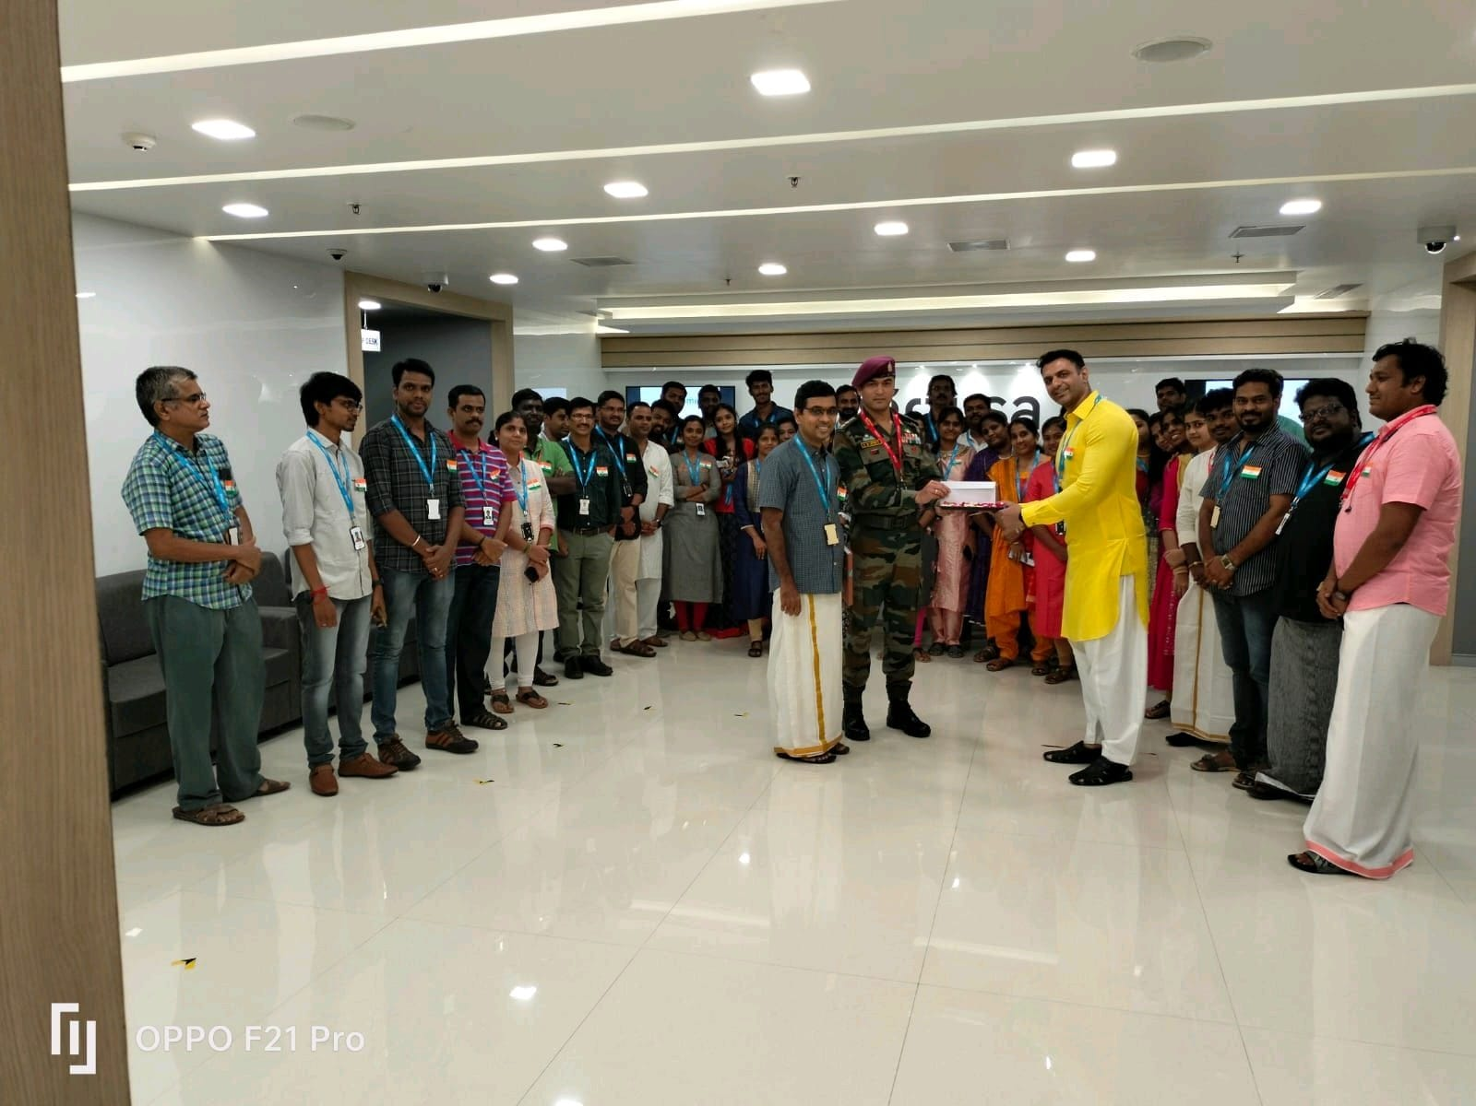
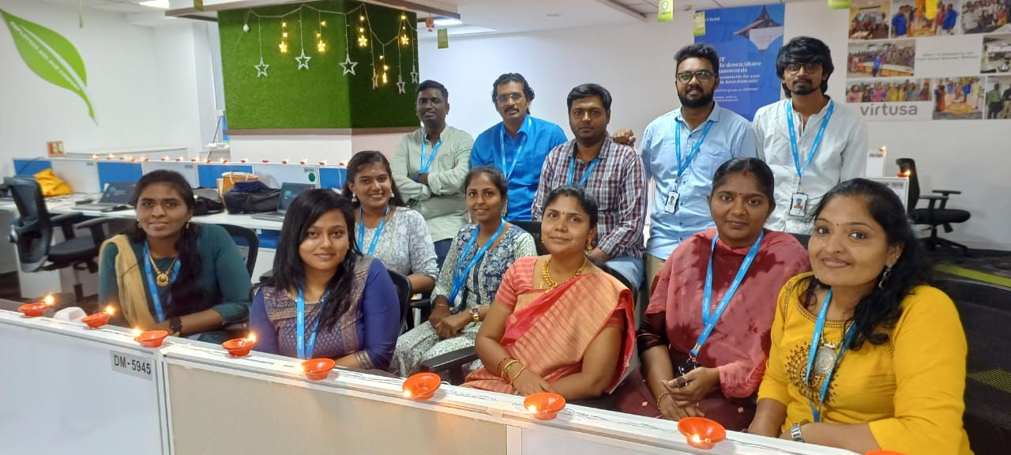
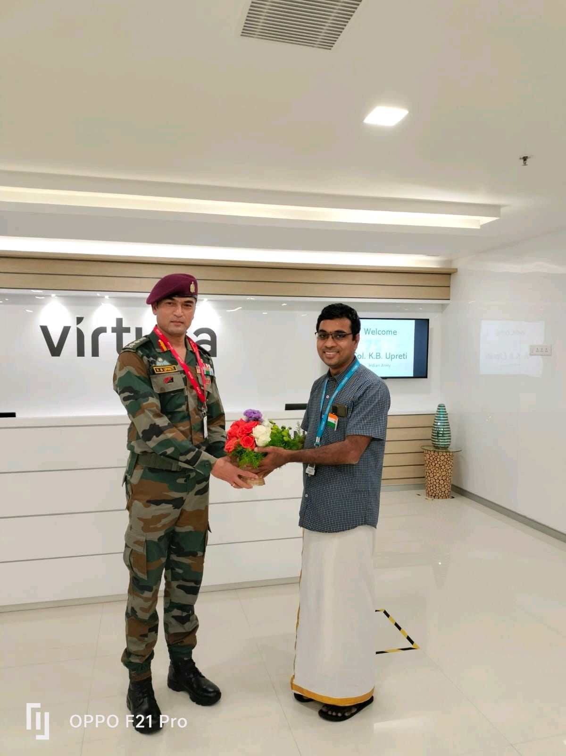
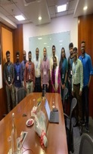
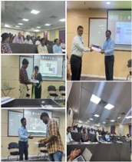
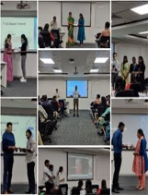
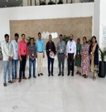
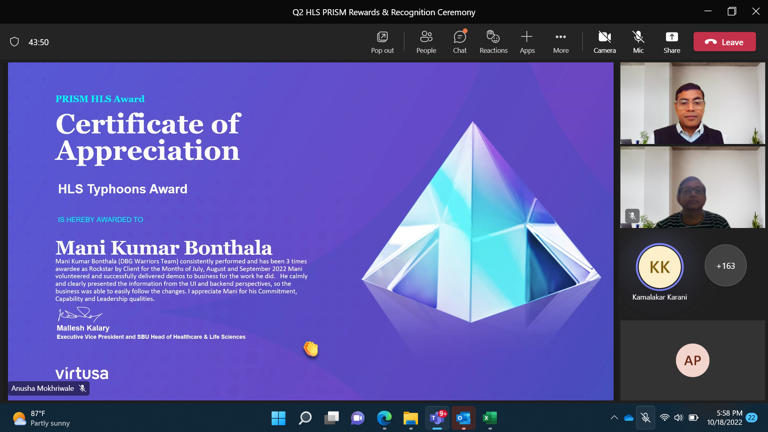
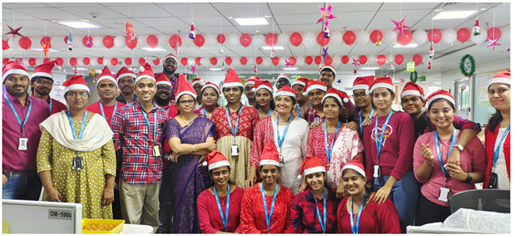
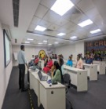
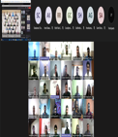
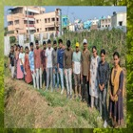
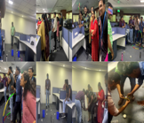

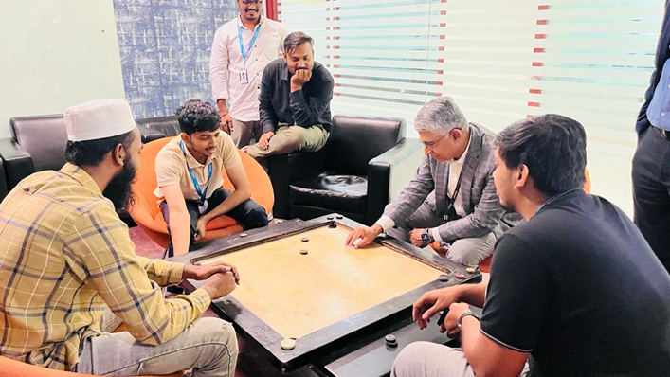
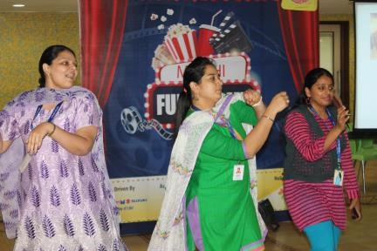
Talent Engagements

Slide 9
Eligibility & Offer Details
Criterion for eligibility:
65% aggregate across 10th, 12th and degree
Stream: BE, BTech- IT, ECE , CSE & related branches like Data Science , AI/ML, Cyber Security etc.
IT (all branch) with no active backlogs
Offers:
2 type of offers
Regular coders- can do basic to intermediate coding; 5LPA
Power coders- can do intermediate to high level coding- gets higher package; 6.5LPA

Slide 10
Interview process
Stage 1- Initial assessment(MCQ+Coding)+ Speech X (Speaking + Listening)
To be conducted in campus – invigilation by college
Includes topics-
Analytical Ability and Problem Solving | Technical Skills
Numerical Ability | Data Structures
Grammar and Vocabulary | Core Java - Classes Objects and Methods
Reading Comprehension | Operating System General concepts
Writing Skills | MySQL - Basics , MySQL – Joins
Coding | ANSI SQL, SQL – Joins
Power coding | MySQL – Subqueries
 | Pseudo Code - Basic Programming
 | Pseudocode - recursion
Stage 2- Coding Event
3 coding questions to crack
To be conducted in campus – invigilation by Virtusa
Stage 3- Technical Interview
Discussion with the technical panel
Stage 4- HR Interview
Discussion with the HR panel

